Slide 1
Hysol Green EMC GR900 for QFN/DFN

Slide 2
Key Features of GR900
Value Proposition
Good reliability performance on QFN package
Excellent compatibility with Copper wire .
Meet MSL3~MSL1/260C requirement.
Good continuous moldability performance.
Good fluidity to avoid W/S issue..
Meet UL94 V-0 flammability rate at 1/8 inch thickness.
Green material without Br/Sb comply with ROHS.

Slide 3
Formulation & Properties
Item |  | Unit | GR900HD6 | GR900HD3A | GR900 Q1L4 | GR900C
Epoxy Type |  | - | BP/MAR | MAR | MAR/BP | MAR/BP
Filller content |  | wt% | 85 | 87 | 89 | 86.5
Filller cut size |  | um | 75 | 75 | 75 | 53
Flame Retardant |  | - | None | None | None | None
Spiral Flow |  | inch | 53 | 51 | 49 | 55
Gel Time |  | sec | 28 | 40 | 36 | 38
Shore-D Hardness |  | - | 77 | 80 | 82 | 81
Viscosity |  | Pa.s | 11 | 12 | 14 | 13
Flexural Modulus at RT |  | (Mpa) | 18000 | 18810 | 22646 | 19000
Flexural Strengths at RT |  | (Mpa) | 151 | 123 | 158 | 150
Flammability |  | - | V-0 | V-0 | V-0 | V-0
Tg |  | ºC | 111 | 114 | 124 | 120
a1 |  | 10⁻⁶/ºC | 11 | 10 | 7 | 11
a2 |  | 10⁻⁶/ºC | 35 | 33 | 24 | 37
Shrinkage |  | % | 0.24 | 0.29 | 0.19 | 0.3
Tab Pull After PMC | Cu | N | 443 | 426 | 430 | 435
 | AG | N | 453 | 445 | 386 | 379
Tab Pull after MSL3 | Cu | N | 411 | 306 | 346 | 349
 | AG | N | 248 | 362 | 163 | 171
Specific gravity |  | - | 1.95 | 1.98 | 2.02 | 1.98
pH |  | - | 5.1 | 5.1 | 5.6 | 5.8
CL⁻ |  | ppm | 7 | 5 | 8 | 8
Na⁺ |  | ppm | 3 | 3 | 3 | 3
High end epoxy
High filler loading
Spherical filler type
……
Low stress
Low water absorption
High adhesion
Low viscosity
……

Slide 4


Internal Test
Release Force
Test Method
Inject MC
Step 1. Molding
Sensor
Step 2. Releasing Force
Measuring

Slide 5
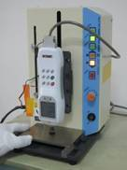
Internal Test
Release Force
Test Result
Test condition
Mold temperature: 175ºC
Cure time: 80+60sec
Lower release force, more continuous mold shots.

Slide 6
Internal Test
Adhesion Force
Test Method
Test piece preparation condition
  Mold Temperature:175ºC
  LF Plate :Cu, Ag, Ni, NiPdAu
  PMC condition: 4 hrs @ 175ºC
  Pretreatment: MSL3+ IR reflow 260ºC*3 times
Pull direction
Mold compound
Maximum pull force: 530~570 N
Above 570N, tab breaks

Slide 7
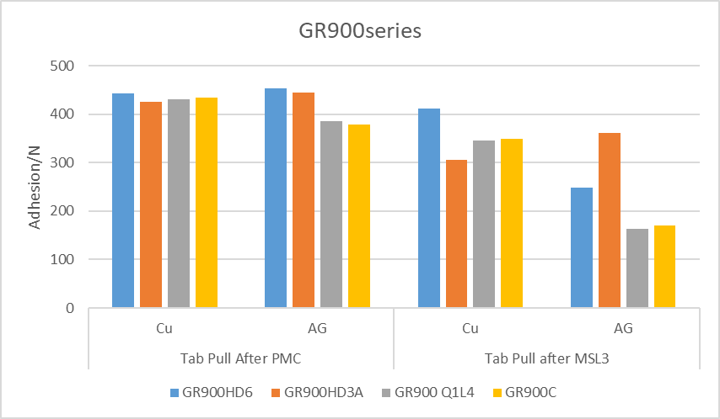
Internal Test
Adhesion Force
Test Result
Good adhesion force, good delamination performance.

Slide 8
Beta Site Performance(S*J)
Reliability
Device Information
EMC | GR900 Q1L4
Package Type | DFN3*2 8L
Lead Frame Density | R16 X C23 X Block 4
Lead Frame Supplier | A**
Lead Frame Surface | Cu base, Ag plated on pad & inner lead
Die Size | 710*610 um/715*610 um
Die Thickness | 230 um
Die Attach | 84-1 LMISR4
Wire Type | PdCu
Wire Diameter | 1.5mil
Mold Model | Auto

Slide 9
Beta Site Performance(S*J)
Reliability
Reliability Test procedure
Electric Test
SAT before MSL
MSL1 Test
SAT after MSL
Electric Test
PCT
HTST
THT
TCT
Electric Test

Slide 10
Beta Site Performance(S*J)
Reliability
Reliability Test Result
Item | Condition | Sample Size | Result
SAT | MSL1, IR Reflow 3x, 260 ℃ | 128 | 0/128
PCT | 121℃, 100%RH, 205kPa, 168hours | 32 | 0/32
TCT | -65 ℃ - 150 ℃, 500cycles | 32 | 0/32
HTST | 150 ℃, 500hours | 32 | 0/32
THT | 85 ℃, 85%RH, 500hours | 32 | 0/32

Slide 11
Beta Site Performance(S*J)
Reliability
SAT pictures after MSL1
Focus on die top
Focus on lead(2 MOS/unit)

Slide 12
Beta Site Performance(S*J)
Reliability
SAT pictures after MSL1
Focus on pad
T-scan

Slide 13
Beta Site Performance(S*J)
Workability
Wire Sweep
PKG Type | DFN3*2
Wire Type | PdCu
Wire Diameter | 1.5mil
Wire Sweep | <15%

Slide 14
Beta Site Performance(C*J)
Reliability
Device Information
EMC | GR900C
Package Type | DFN0603
Package Size | 0.62x0.32x0.32mm
Block No. | 4
Lead Frame Supplier | A**
Lead Frame Surface | Ni/Pd/Au
Die Size | 0.2*0.2
Die Attach | 84-1 LMISR4
Wire Type | Au
Mold Model | Auto

Slide 15
Beta Site Performance(C*J)
Reliability
Reliability Test procedure
Electric Test
SAT before MSL
MSL1 Test
SAT after MSL
Electric Test
PCT
HTST
THT
TCT
Electric Test

Slide 16
Beta Site Performance(C*J)
Reliability
Reliability Test Result
Item | Condition | Sample Size | Result
SAT | MSL1, IR Reflow 3x, 260 ℃ | 128 | 0/128
PCT | 121℃, 100%RH, 2atm, 96hours | 32 | 0/32
TCT | -65 ℃ - 150 ℃, 1000cycles | 32 | 0/32
HTST | 150 ℃, 1000hours | 32 | 0/32
THT | 85 ℃, 85%RH, 1000hours | 32 | 0/32

Slide 17
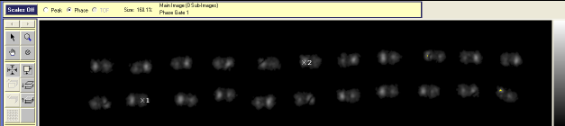
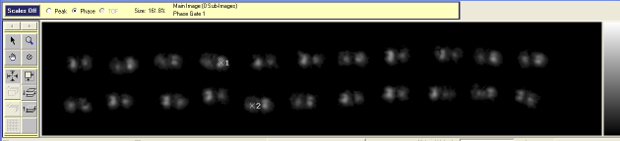
Beta Site Performance(C*J)
Reliability
SAT pictures
Before MSL1
After MSL1

Slide 18
Beta Site Performance(Ons**)
Reliability
GR900C passed MSL1 on QFN5x5
Remark:1.EMC: GR900C; 2.PKG: QFN5x5mm; 3.Block No.: 3;
4.L/F: Cu with Ag plating; 5.Ag paste:ABL8600; 6.End customer: Bosch.

Slide 19
Beta Site Performance(TF*)
Reliability
GR900 passed MSL1 on UDFN-055
Before MSL1
After MSL1

Slide 20
Beta Site Performance(TF*)
Continuous mold ability
Molding Parameter
PKG | Parameter | SPEC | Real value
UDFN-055 | Mold temp | 175℃±5℃ | 175℃
 | Clamp pressure | 350±40KN | 360KN
 | Transfer pressure | 8±1Mpa | 7.5Mpa
 | Transfer time | 10±3sec | 10.2sec
 | Cure time | 100±10sec | 110sec

Slide 21
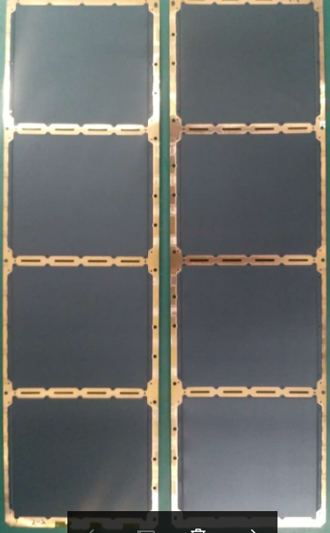
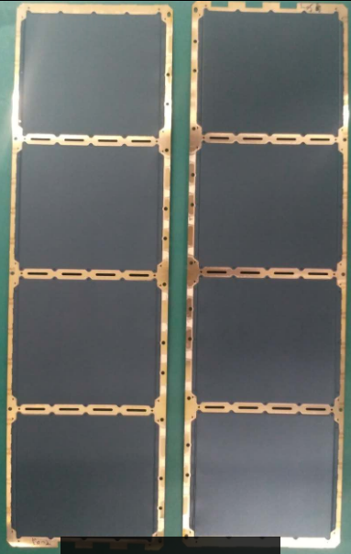
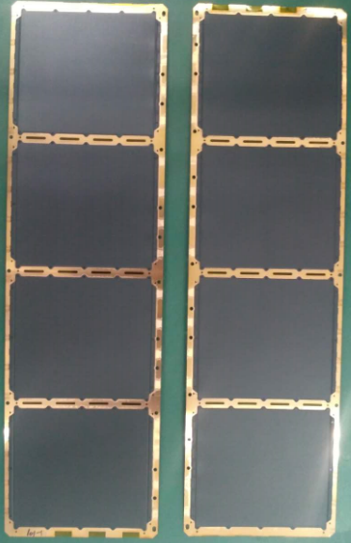
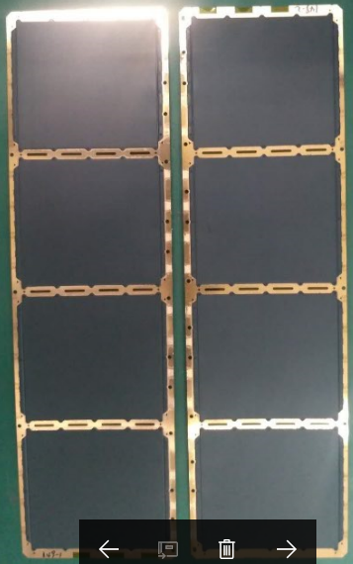
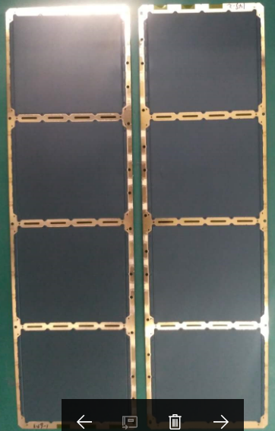
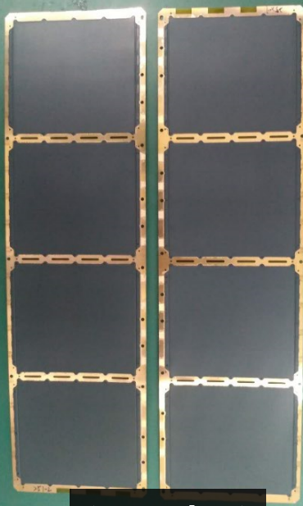
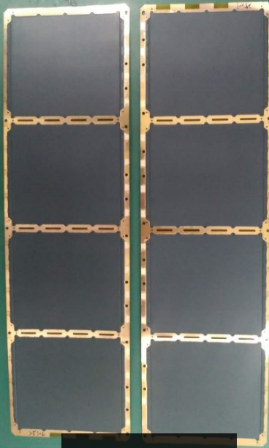
Beta Site Performance(TF*)
Continuous mold ability
1）Appearance inspection result is OK，There is no sticking or PKG crack.
Appearance inspection
Shot No. | 1 | 50 | 100 | 150 | 200 | 250 | 300
Appearance | OK | OK | OK | OK | OK | OK | OK

Slide 22
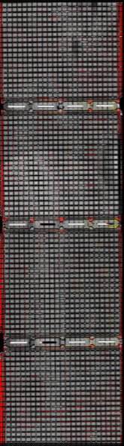
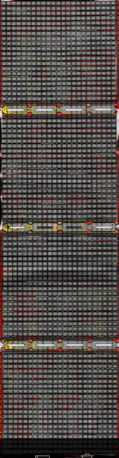
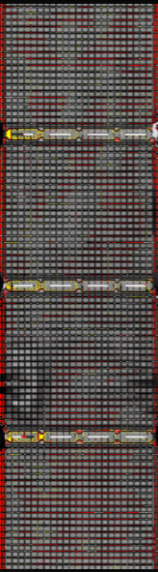
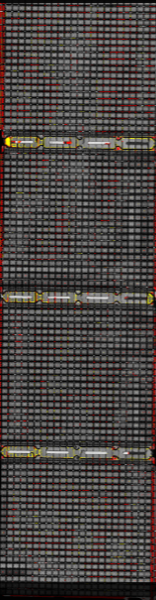
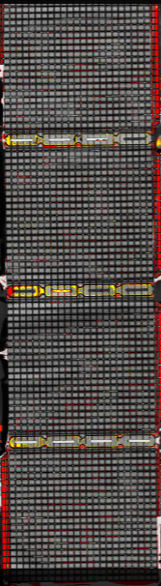
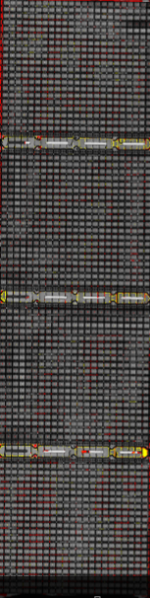

Beta Site Performance(TF*)
Continuous mold ability
SAT check after PMC + Deflash + Plating + Sawing
Shot No. | 1 | 50 | 100 | 150 | 200 | 250 | 300
SAT | OK | OK | OK | OK | OK | OK | OK

Slide 23
Beta Site Performance(Hua*)
Reliability
Device Information
EMC | GR900HD6
Package Type | QFN0505
Package Size | 5x5x0.85mm
Block No. | 1
Lead Frame Supplier | HDS
Lead Frame Surface | Cu/Ag
Die Thickness | 150um
Die Attach | ATB-F125E2(30)
Wire Type | Cu wire(Pd)/ Au
Mold Model | Auto

Slide 24
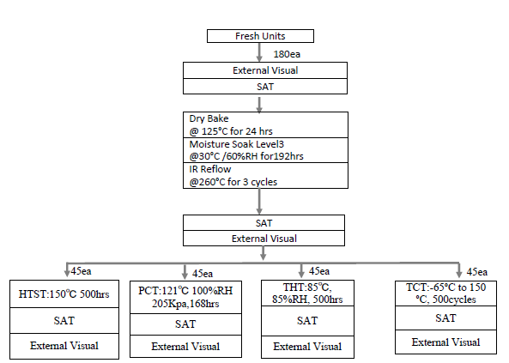
Beta Site Performance(Hua*)
Reliability
Reliability Test procedure

Slide 25
Beta Site Performance(Hua*)
Reliability
Reliability Test Result
Item | Condition | Sample Size | Result
SAT | MSL3, IR Reflow 3x, 260 ℃ | 180 | 0/180
PCT | 121℃, 100%RH, 205Kpa, 168hours | 45 | 0/45
TCT | -65 ℃ - 150 ℃, 500cycles | 45 | 0/45
HTST | 150 ℃, 500hours | 45 | 0/45
THT | 85 ℃, 85%RH, 500hours | 45 | 0/45

Slide 26
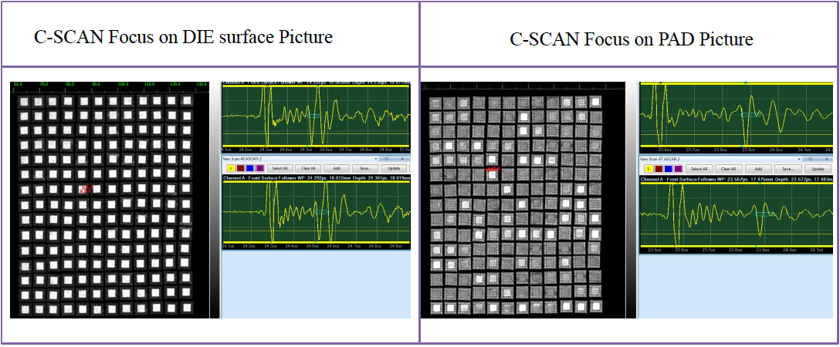
Beta Site Performance(Hua*)
Reliability
SAT pictures after MSL3

Slide 27
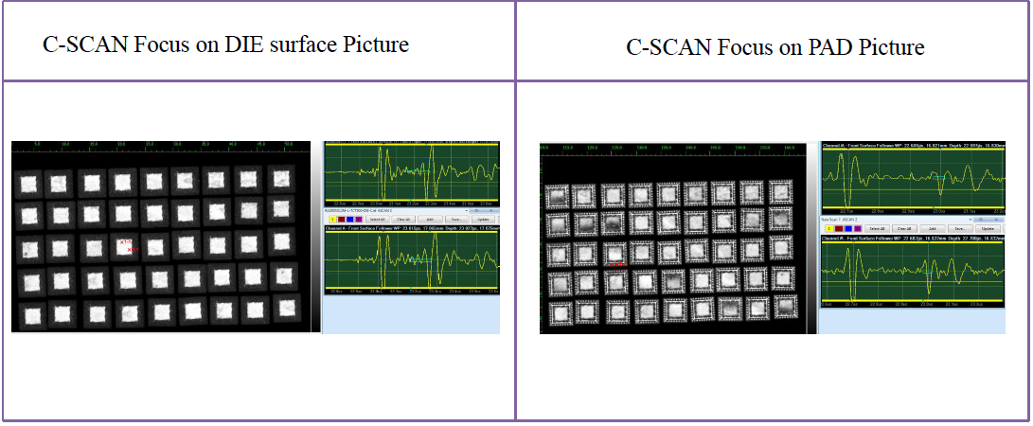
Beta Site Performance(Hua*)
Reliability
SAT pictures after TCT500

Slide 28
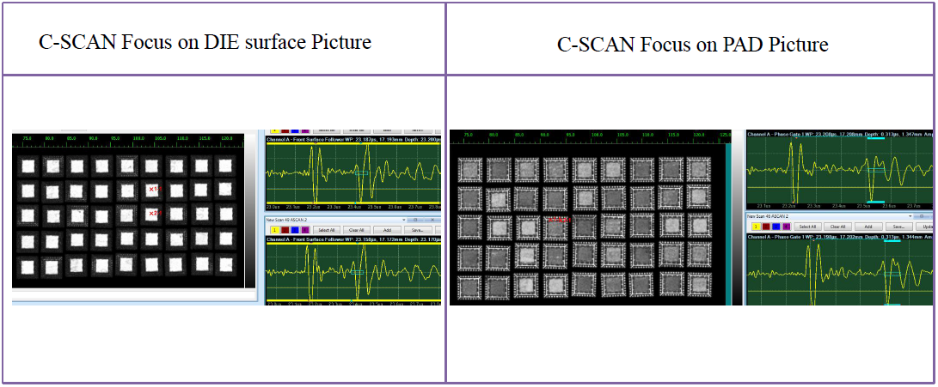
Beta Site Performance(Hua*)
Reliability
SAT pictures after THT500

Slide 29
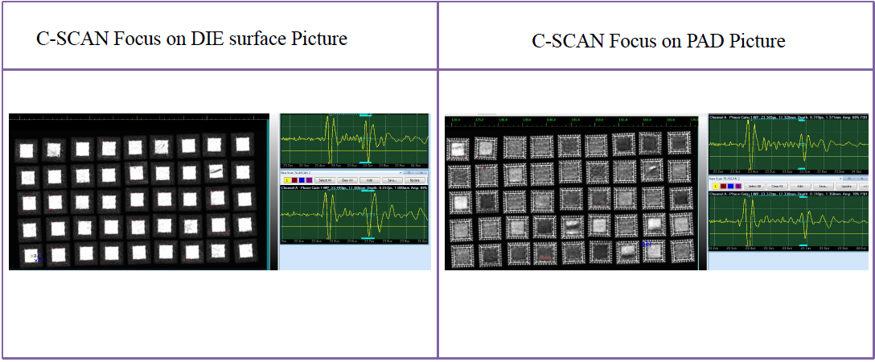
Beta Site Performance(Hua*)
Reliability
SAT pictures after PCT168

Slide 30
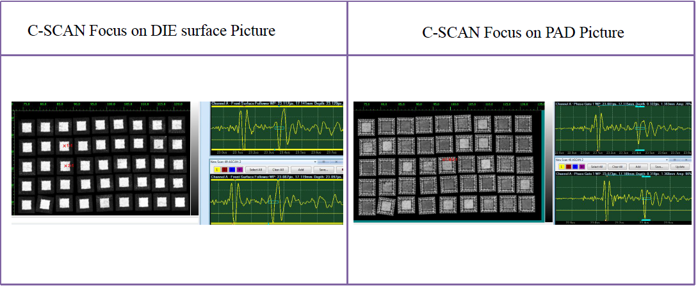
Beta Site Performance(Hua*)
Reliability
SAT pictures after HTSL500

Slide 31
Beta Site Performance(Hua*)
Reliability
Device Information
EMC | GR900HD3A
Package Type | QFN0707
Package Size | 7x7x0.85mm
Block No. | 1
Lead Frame Supplier | QPL
Lead Frame Surface | Cu/Ag
Die Thickness | 150um
Die Attach | ATB-F125E2(30)
Wire Type | Cu wire(Pd)/ Au
Mold Model | Auto

Slide 32
Beta Site Performance(Hua*)
Reliability
Reliability Test procedure

Slide 33
Beta Site Performance(Hua*)
Reliability
Reliability Test Result
Item | Condition | Sample Size | Result
SAT | MSL3, IR Reflow 3x, 260 ℃ | 180 | 0/180
PCT | 121℃, 100%RH, 205Kpa, 168hours | 45 | 0/45
TCT | -65 ℃ - 150 ℃, 500cycles | 45 | 0/45
HTST | 150 ℃, 500hours | 45 | 0/45
THT | 85 ℃, 85%RH, 500hours | 45 | 0/45

Slide 34
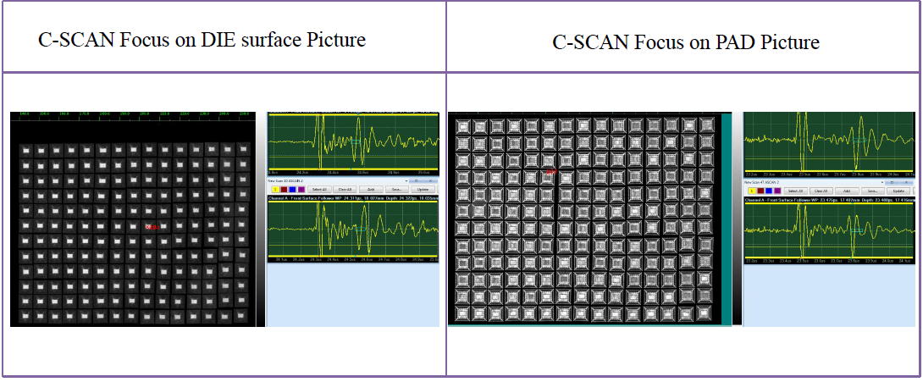
Beta Site Performance(Hua*)
Reliability
SAT pictures after MSL3

Slide 35
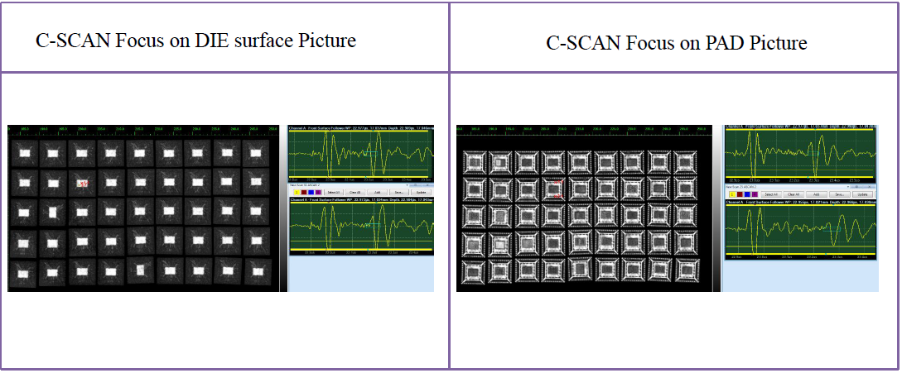
Beta Site Performance(Hua*)
Reliability
SAT pictures after TCT500

Slide 36
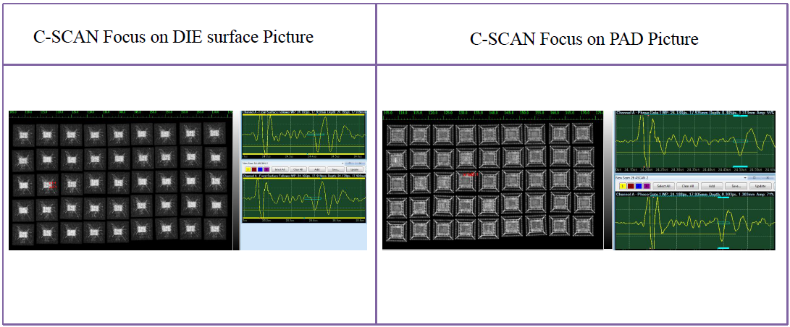
Beta Site Performance(Hua*)
Reliability
SAT pictures after THT500

Slide 37
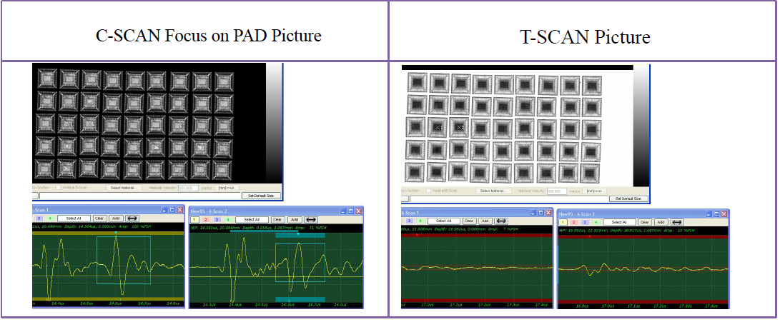
Beta Site Performance(Hua*)
Reliability
SAT pictures after PCT168

Slide 38
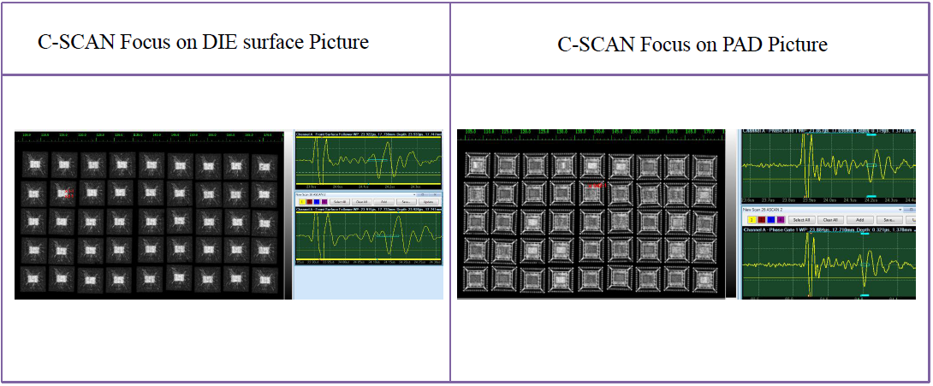
Beta Site Performance(Hua*)
Reliability
SAT pictures after HTSL500

Slide 39
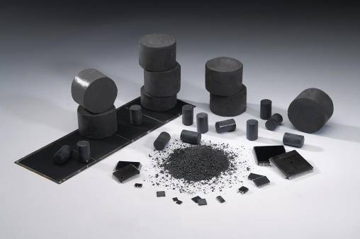
Thank you!

